Slide 1
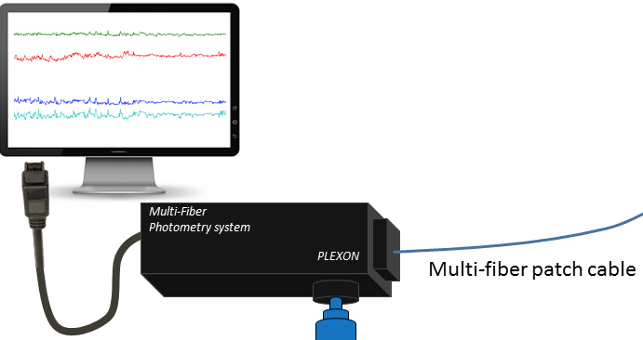

Slide 2
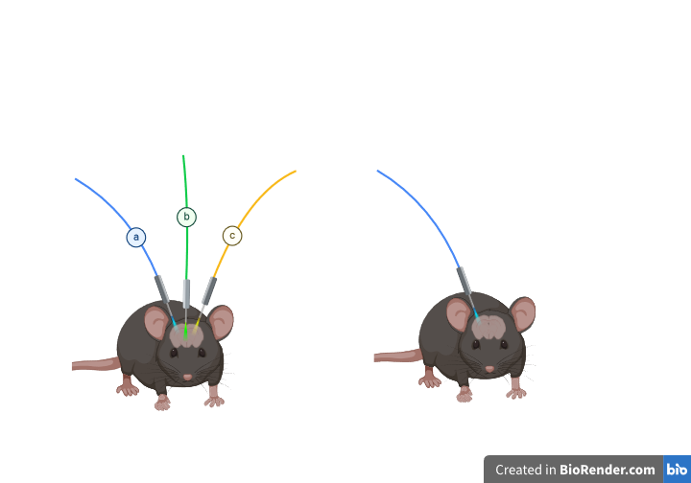
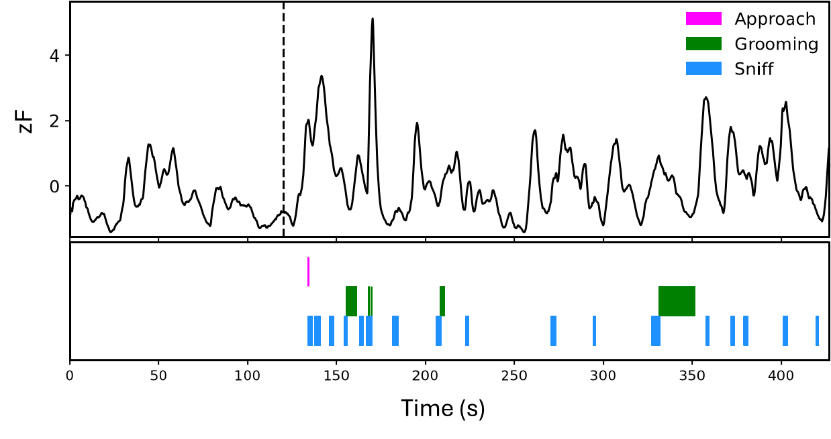
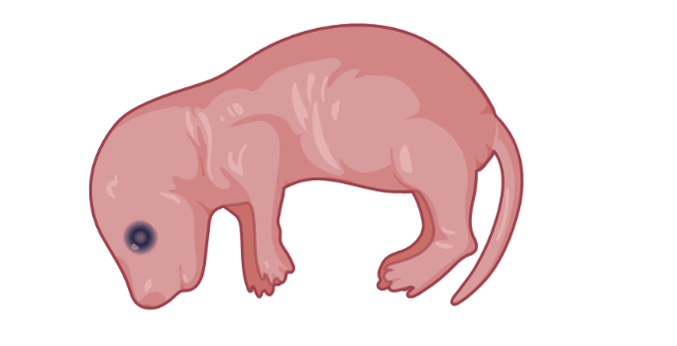
Fiber Photometry
System
Multi-fiber
patch cable
♀ | Virgin Female
Allo-Grooming
Fiber optic
cannula

